Slide 1
Introduction to ML: Part 2
ons
Mahesh Mohan M R
Centre of Excellence in AI
Indian Institute of Technology Kharagpur ons

Slide 2
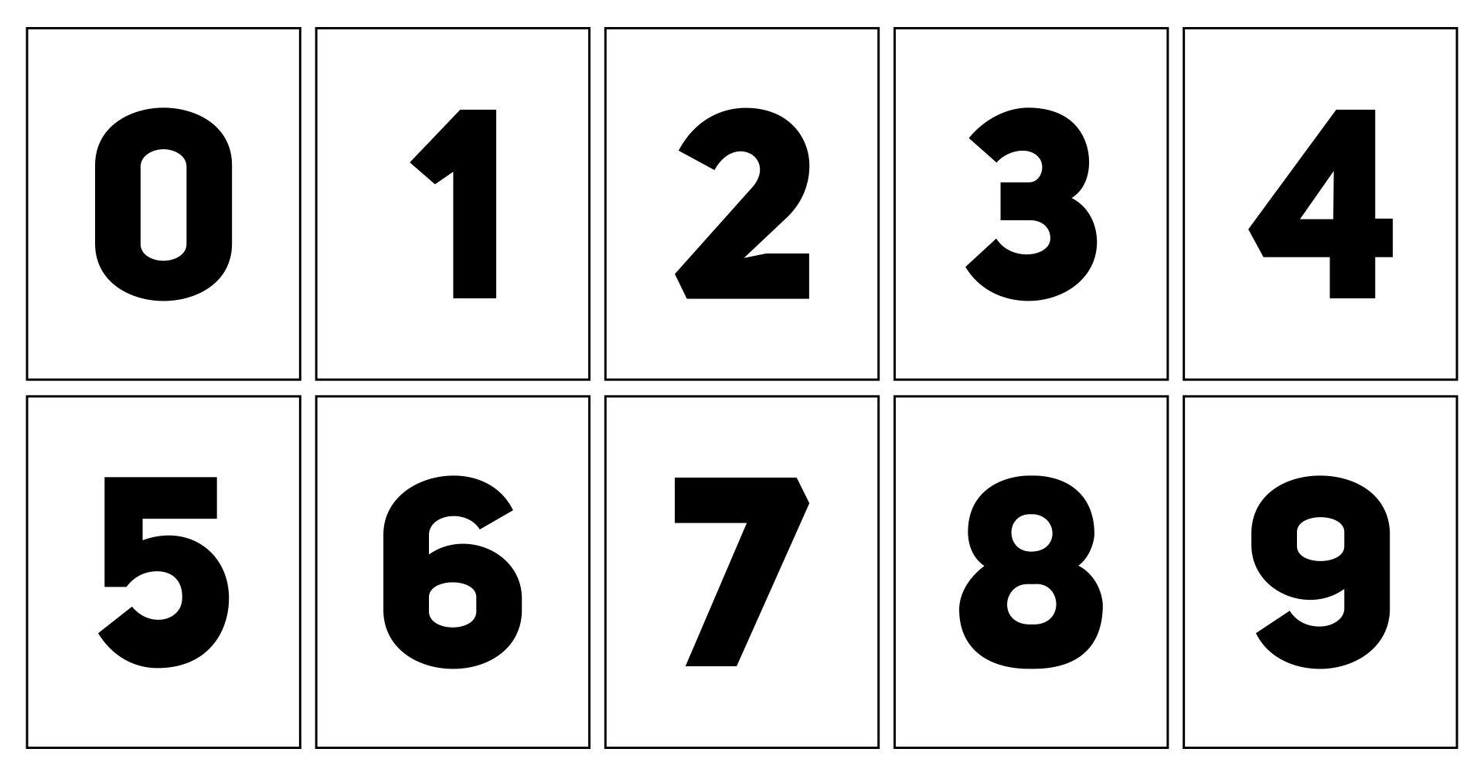
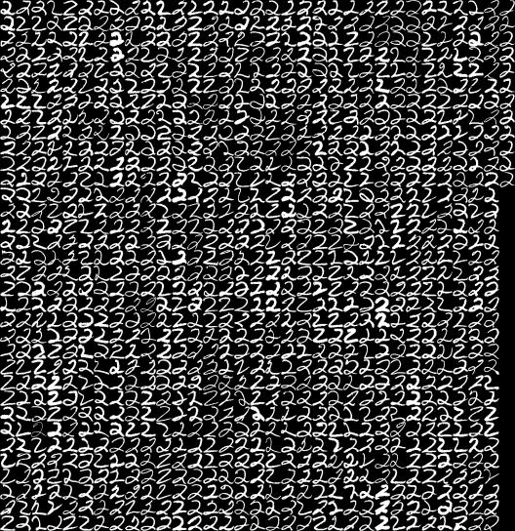
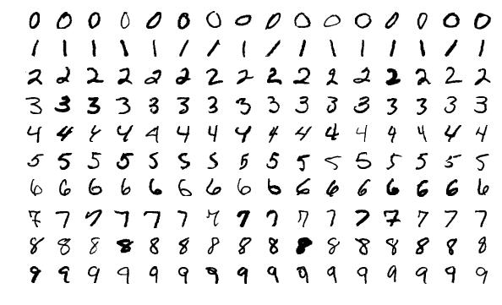
A Motivating Example: Reading Postcode

Slide 3
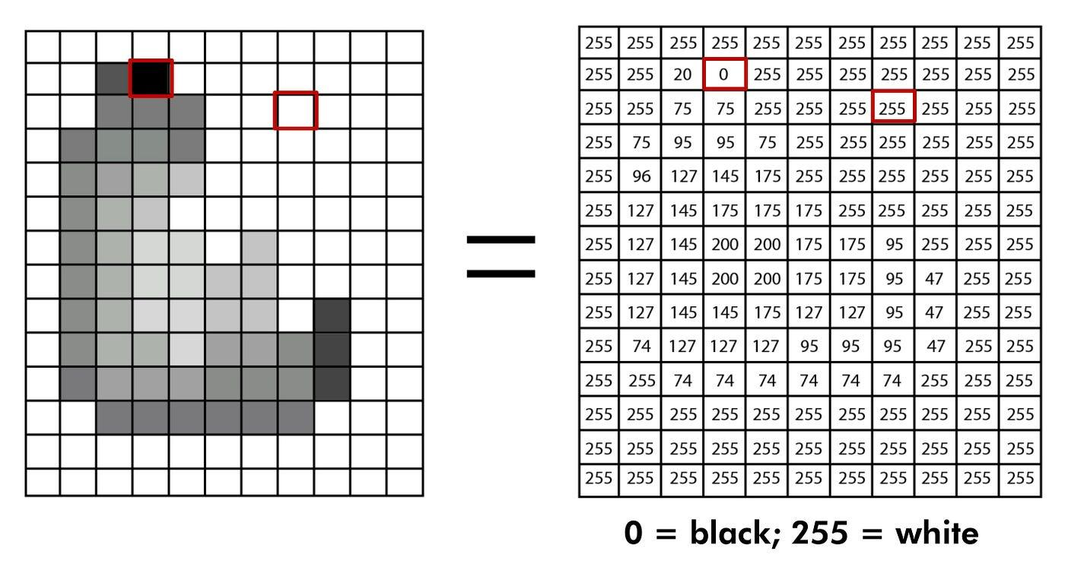
Image Representation in Computer

Slide 4
Introduction to Supervised Learning

Slide 5

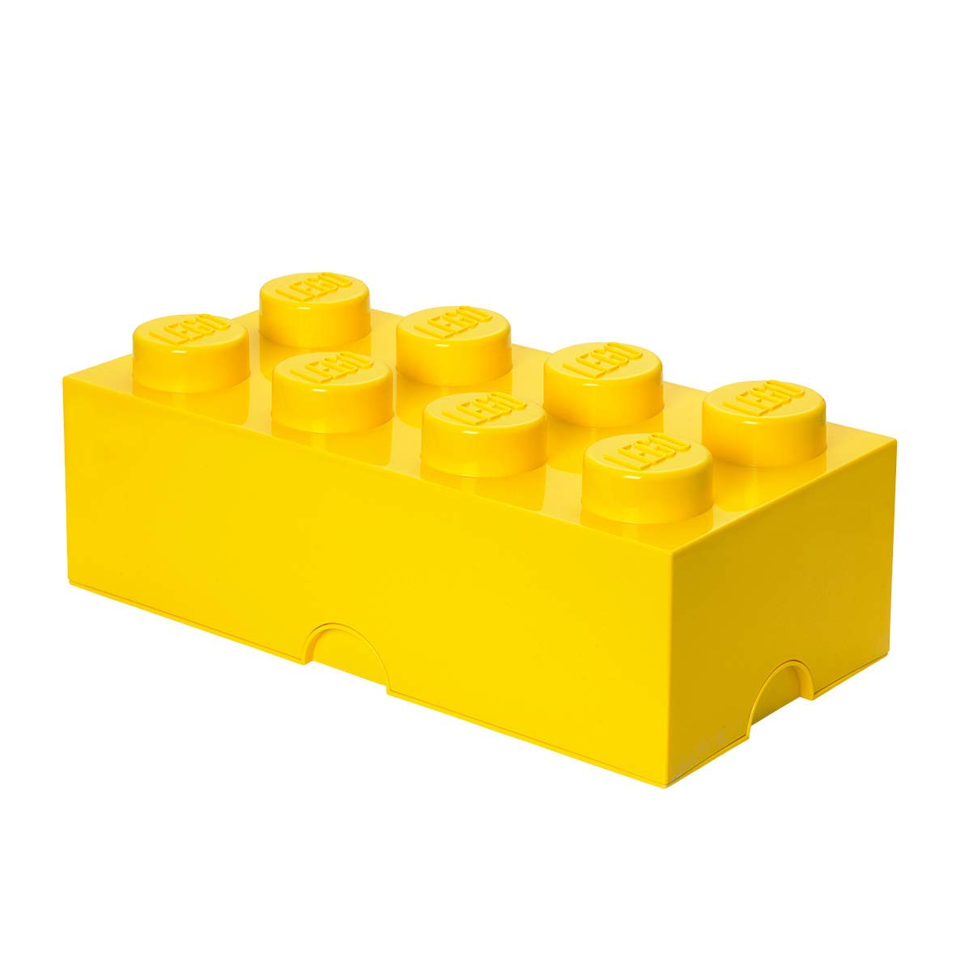


Yellow color

Slide 6
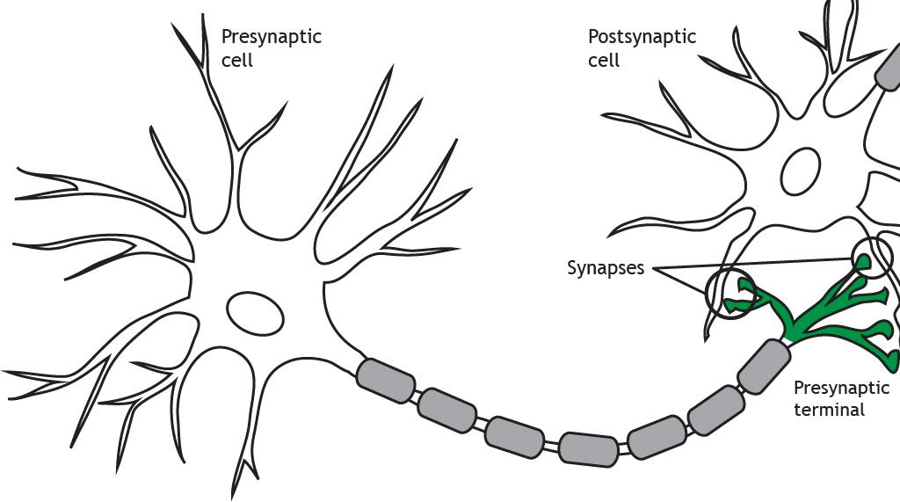
Neurons
Synapses refer to the points of contact between neurons where information is passed from one neuron to the next.

Slide 7
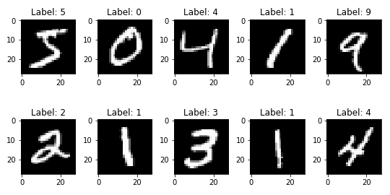
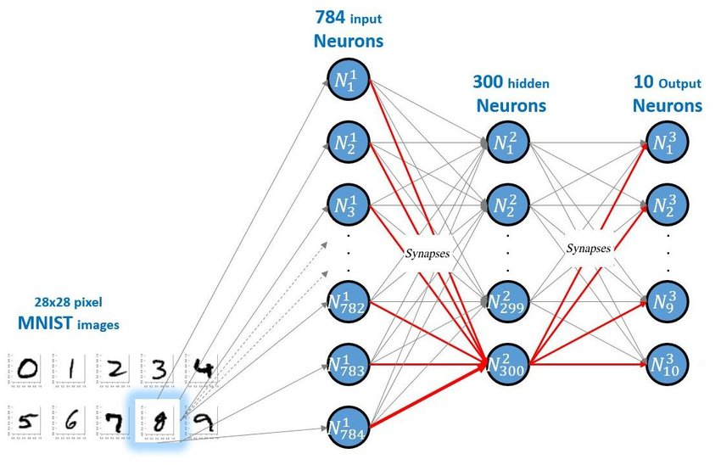
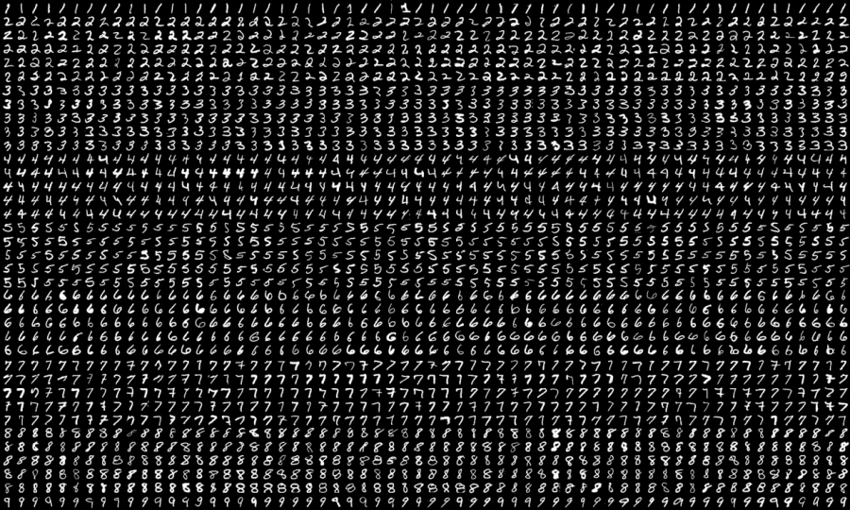
AI Based Solution: Reading Postcode
Neural Network and Training
Data and Labels

Slide 8
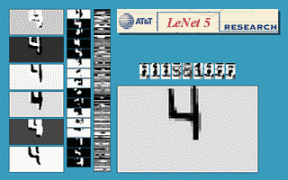
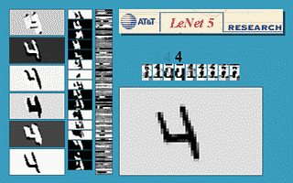
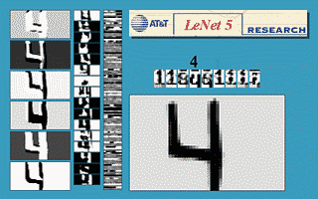
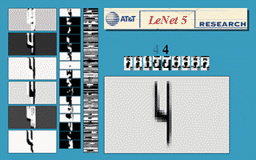
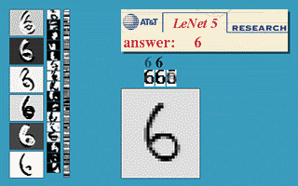
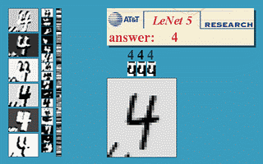
AI for Reading Postcode [LeCun et al.].
Translation invariance
Rotation invariance
Scale invariance
Squeeze invariance
Stroke-width invariance
Noise invariance

Slide 9
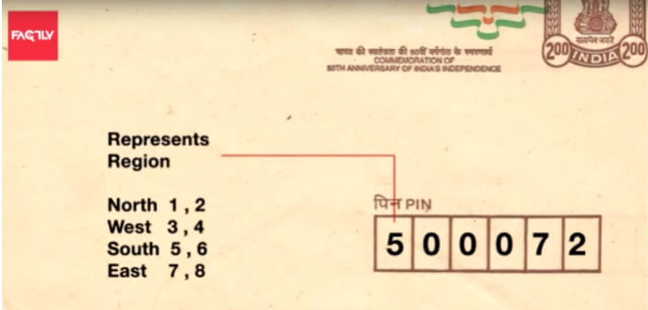
AI: Inference/Testing
0
0
0
0
0
0
0
1
0
0
Testing samples extracted from envelope
Artificial Neural Network (ANN)
O/p

Slide 10
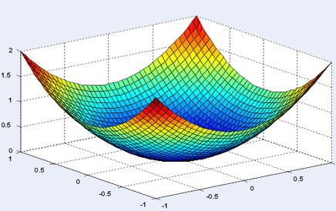
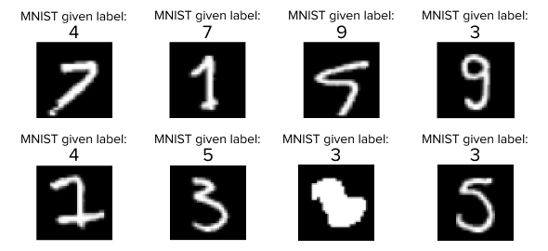
AI: How to Solve it?
4. Optimize Weight
Collect Labelled Dataset
Design ANN Architecture
Define Loss Function
Optimize weights
3. Loss Function
Collect Labelled dataset
2. Design Artificial Neural Network

Slide 11
AI: How to Solve it?
4. Optimize Weight
Collect Labelled Dataset
Design ANN Architecture
Define Loss Function
Optimize weights
3. Loss Function
Collect Labelled dataset
2. Design Artificial Neural Network

Slide 12

Collect Labelled Dataset

Slide 13

AI: How to Solve it?
4. Optimize Weight
Collect Labelled Dataset
Design ANN Architecture
Define Loss Function
Optimize weights
3. Loss Function
Collect Labelled dataset
2. Design Artificial Neural Network

Slide 14
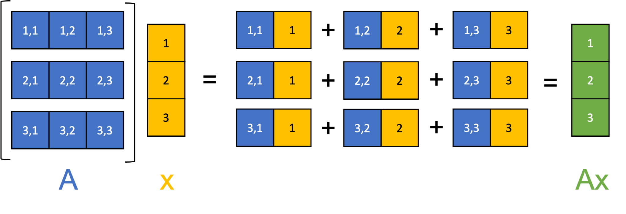
Design ANN Architecture

Slide 15
AI: How to Solve it?
4. Optimize Weight
Collect Labelled Dataset
Design ANN Architecture
Define Loss Function
Optimize weights
3. Loss Function
Collect Labelled dataset
2. Design Artificial Neural Network

Slide 16
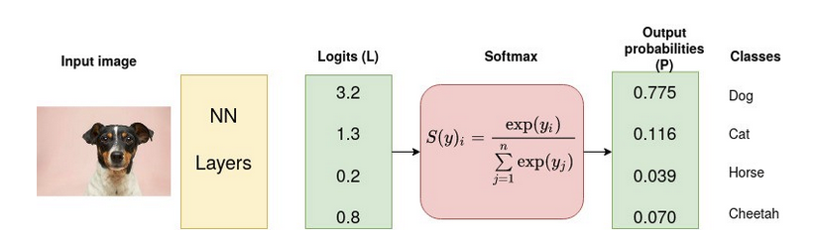
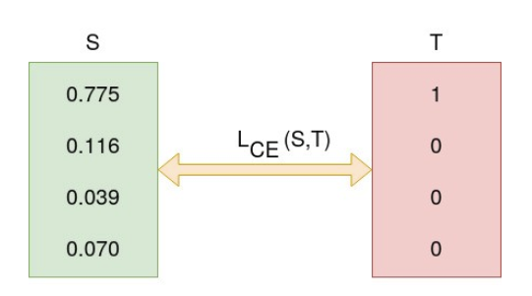
Cross-entropy Loss
What we want?

Slide 17
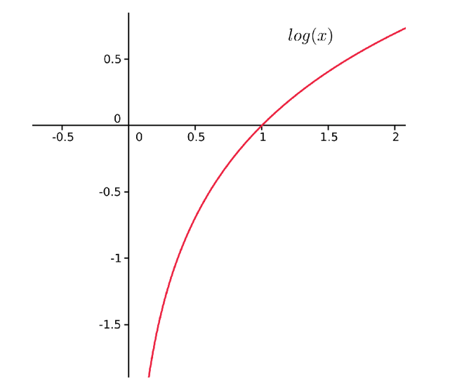
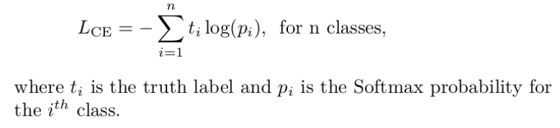
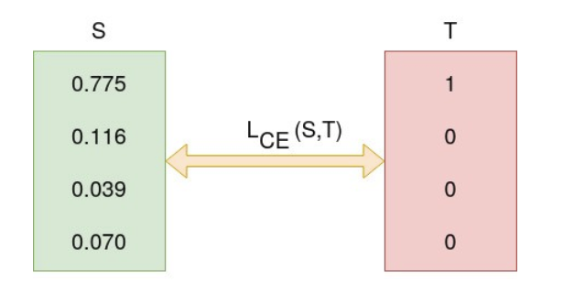
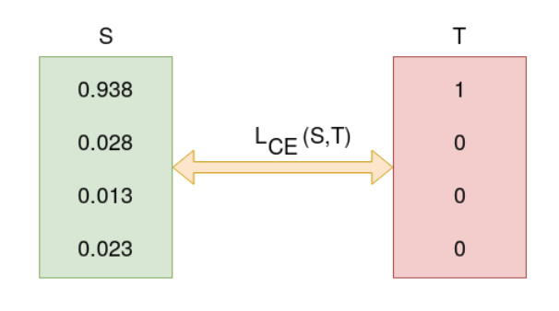
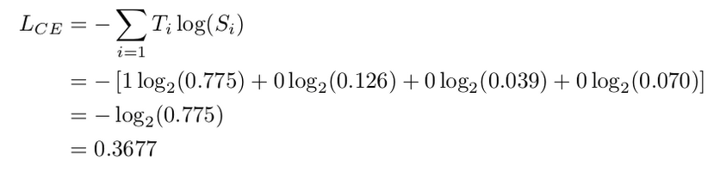
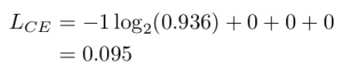
Cross-entropy Loss?

Slide 18
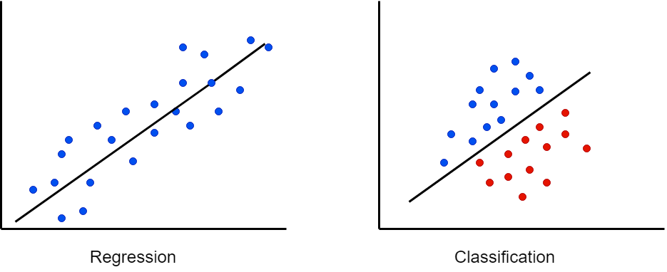
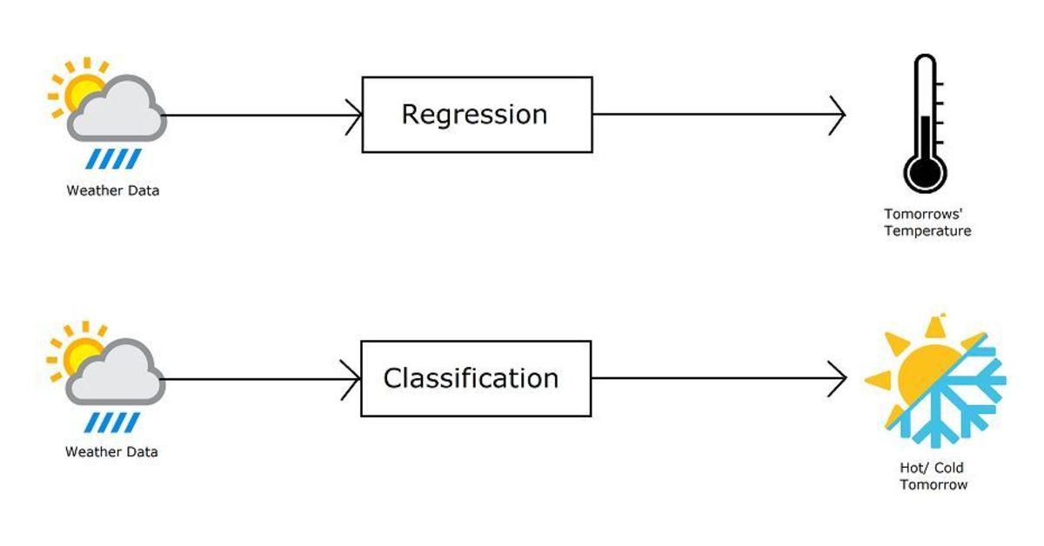
Classification vs Regression

Slide 19
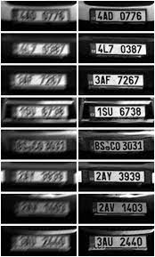
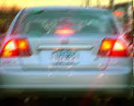
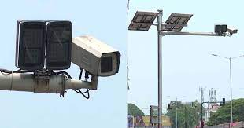
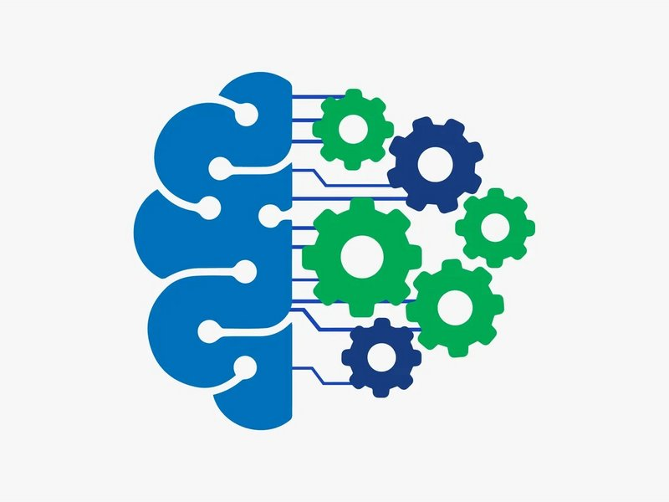
A Real Life Application
ML model
Input and Output are similar

Slide 20
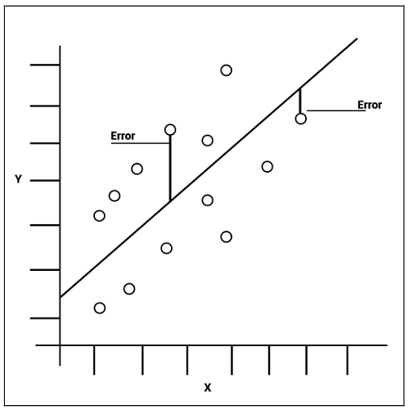
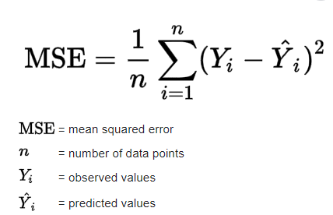
MSE Loss

Slide 21
AI: How to Solve it?
4. Optimize Weight
Collect Labelled Dataset
Design ANN Architecture
Define Loss Function
Optimize weights
3. Loss Function
Collect Labelled dataset
2. Design Artificial Neural Network

Slide 22
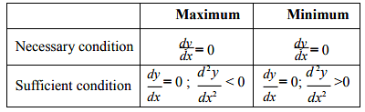
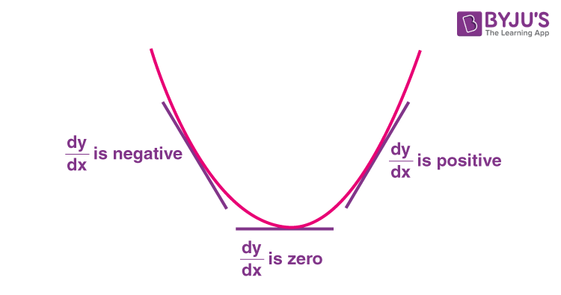
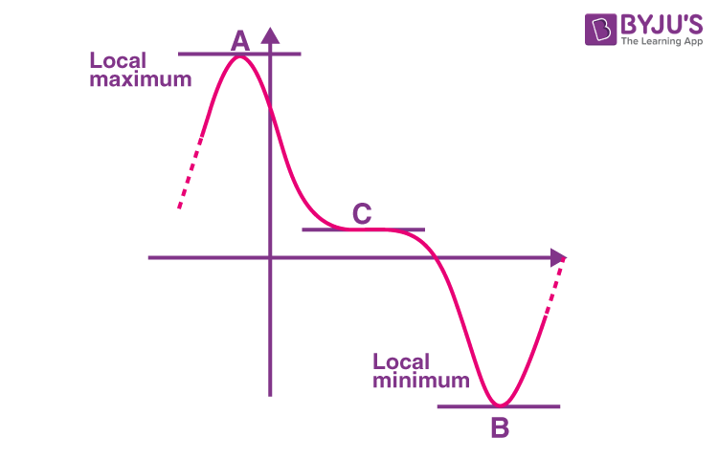
Optimizing ANN: Closed Form Expression

Slide 23
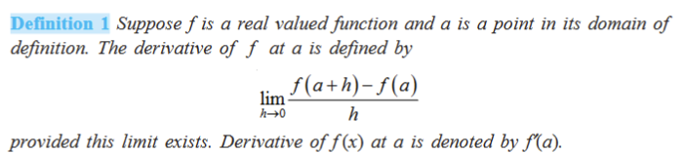
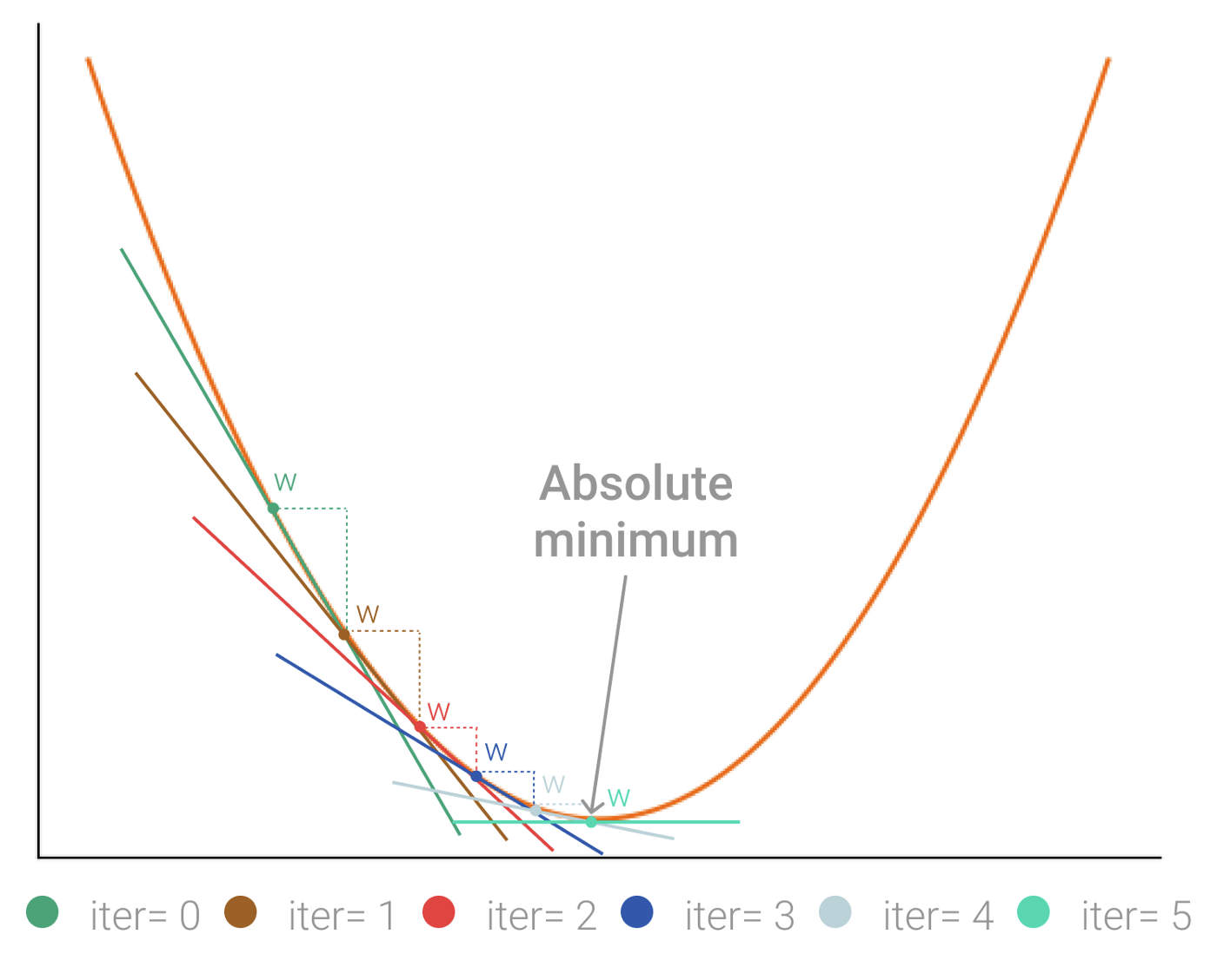
Optimizing ANN: Gradient Descent
What happens to Loss f(a+h) - f(a) if the weight update h is -𝝀 f’(a)?
Note: 𝝀 >0
Loss: Denoted by f()
ANN weight: denoted by a

Slide 24
Optimizing ANN: Gradient Descent
What happens to Loss f(a+h) - f(a) if the weight update h is -𝝀 f’(a)?
Note: 𝝀 >0
Answer: f(a+h) - f(a) is negative, which means f(a+h) ≤ f(a).
Loss: Denoted by f()
Optimizing ANN: Update each ANN weight a as a - 𝝀 f’(a), where 𝝀 is the learning rate.
ANN weight: denoted by a

Slide 25
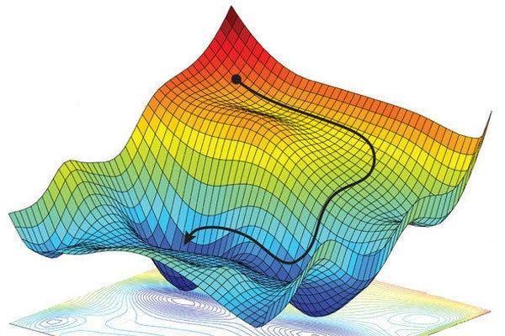
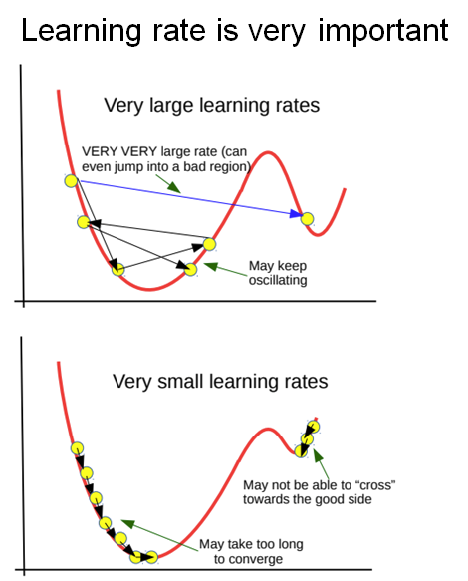
Importance of Learning Rate
An Ideal Case
of Loss function
A Practical Case
of Loss function

Slide 26
AI: How to Solve it?
4. Optimize Weight
Collect Labelled Dataset
Design ANN Architecture
Define Loss Function
Optimize weights
3. Loss Function
Collect Labelled dataset
2. Design Artificial Neural Network

Slide 27
Parametric vs Nonparametric Methods?
4. Optimize Weight
Collect Labelled Dataset
Design ANN Architecture
Define Loss Function
Optimize weights
3. Loss Function
Collect Labelled dataset
2. Design Artificial Neural Network

Slide 28
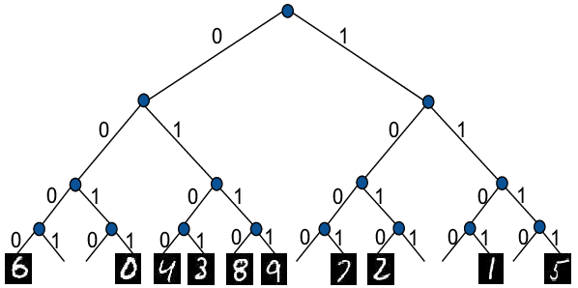
Parametric vs Nonparametric Methods?
4. Optimize Weight
Collect Labelled Dataset
Design ANN Architecture
Define Loss Function
Optimize weights
2. Design Artificial Neural Network
3. Loss Function
Collect Labelled dataset

Slide 29
Introduction to Unsupervised Learning

Slide 30





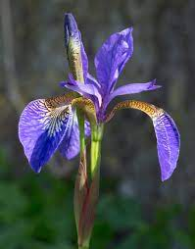
vs

Slide 31

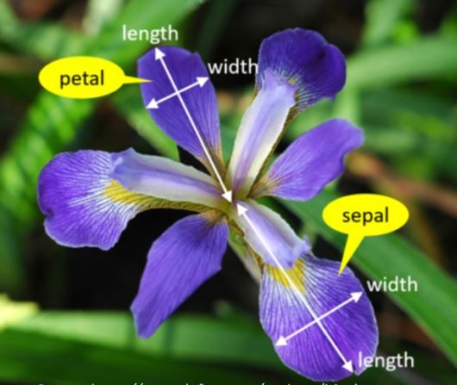
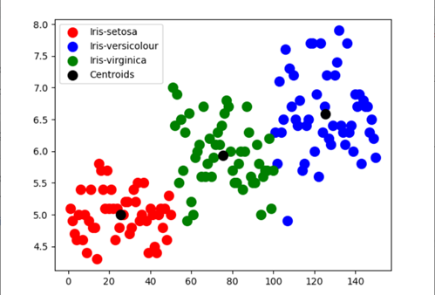
Clustering

Slide 32
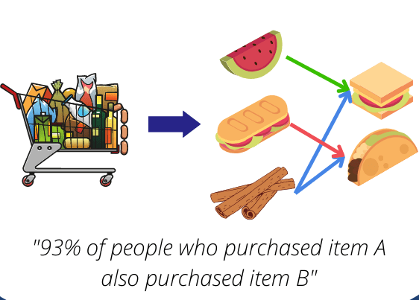
Association

Slide 33
Introduction to Reinforcement Learning

Slide 34
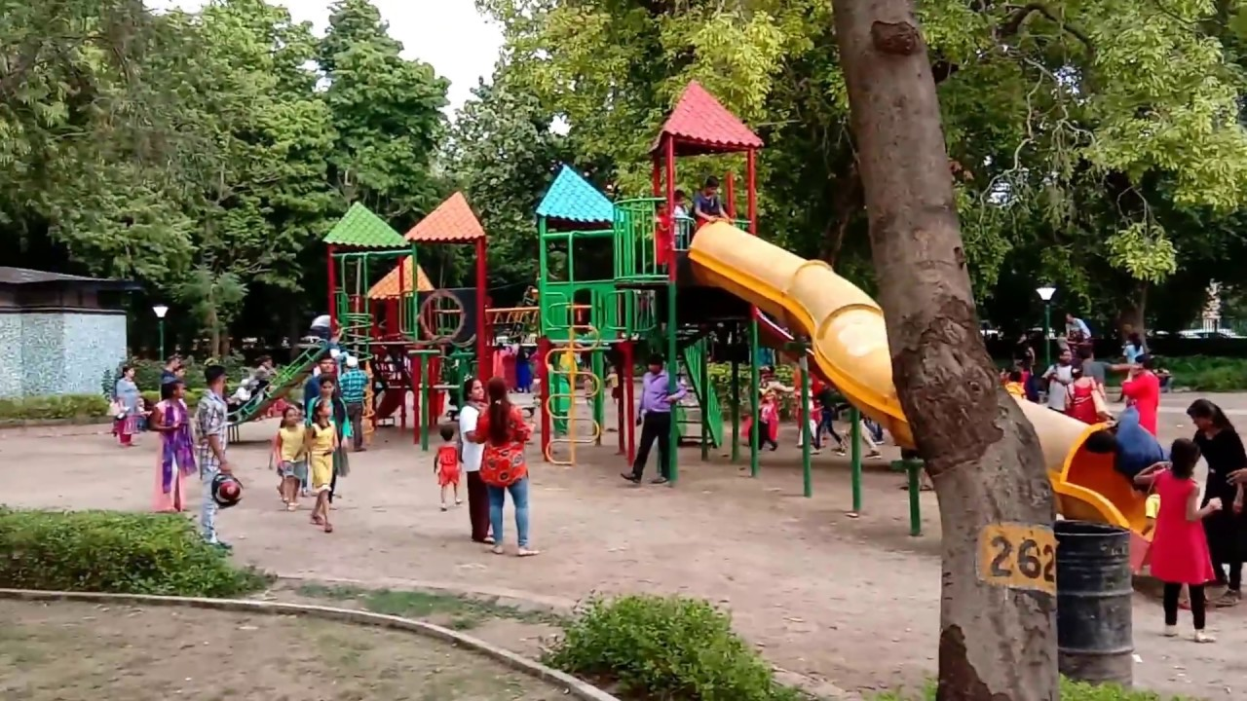
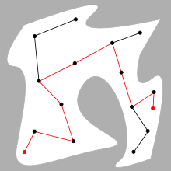

Slide 35
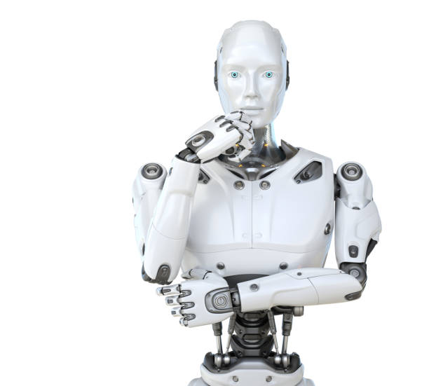


Reinforcement Learning

Slide 36





Reinforcement Learning

Slide 37



Reinforcement Learning
Objective: Move forward while minimizing how often it fails and the energy it expends.
Learning Phase

Slide 38



Reinforcement Learning
Objective: Move forward while minimizing how often it fails and the energy it expends.
Learning Phase

Slide 39


Slide 40

Summary of “Intro to Machine Learning”
Parametric/Non-parametric

